Slide 1
CSE 1125
Digital Logic Design (CSE 1325)
Md. Enamul Haque (MEHq)
enamul.m3h@gmail.com

Slide 2
Digital Logic Design?
Digital
Concerned with the interconnection among digital components and modules
Best Digital System example is General Purpose Computer.
Logic Design
Deals with the basic concepts and tools used to design digital hardware consisting of logic circuits
Circuits to perform arithmetic operations (+, -, x, ÷)

Slide 3
Why it is called Digital Logic Design!
It deals with designing circuits that manipulate digital signals, which are discrete and have two states:
high (usually representing a logical '1’)
low (usually representing a logical '0')

Slide 4
Outline of this lecture
Base conversions
Decimal ↔ Binary
Any base → Decimal
Octal ↔ Binary
Hexadecimal ↔ Binary
Binary Codes
Binary Coded Decimal (BCD)
Binary arithmetic
Single Bit Addition with Carry
Multiple Bit Addition
BCD Addition

Slide 5
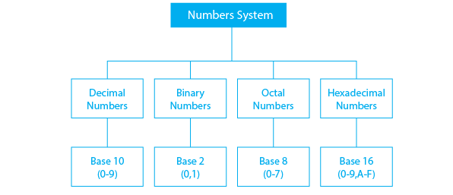
Numbers system

Slide 6
Numbers System
231.45 =
Here, 10 is called the radix or base of the number system
In 10-base systems, there are 10 symbols (‘0’, ‘1’, … , ‘9’)
In n-base system, there are n symbols (‘0’, ‘1’, … , ‘n-1’)
In binary (2-base) system, there are 2 symbols (‘0’, and ‘1’)

Slide 7
Is it possible to create our own number system?
Yes! We can.
n-base system, there are n symbols (0, 1, … , n-1)

Slide 8
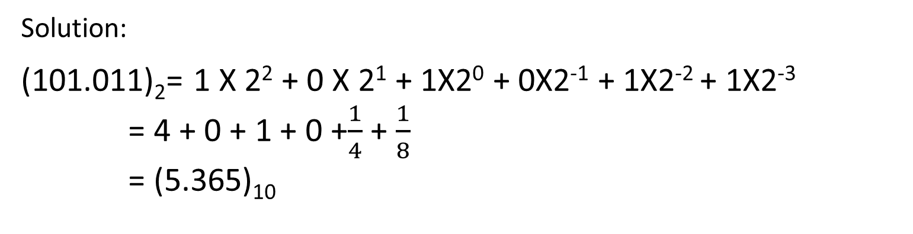
Binary → Decimal
(101.011)₂= ( )₁₀
^{Solution:}
(101.011)₂= 1 X 2² + 0 X 2¹ + 1X2⁰ + 0X2⁻¹ + 1X2⁻² + 1X2⁻³
= 4 + 0 + 1 + 0 +$\frac{1}{4}$ + $\frac{1}{8}$
= (5.365)₁₀

Slide 9
Binary → Decimal
Try Solving yourself:
(00111.10100)₂
(1101.11100)₂

Slide 10
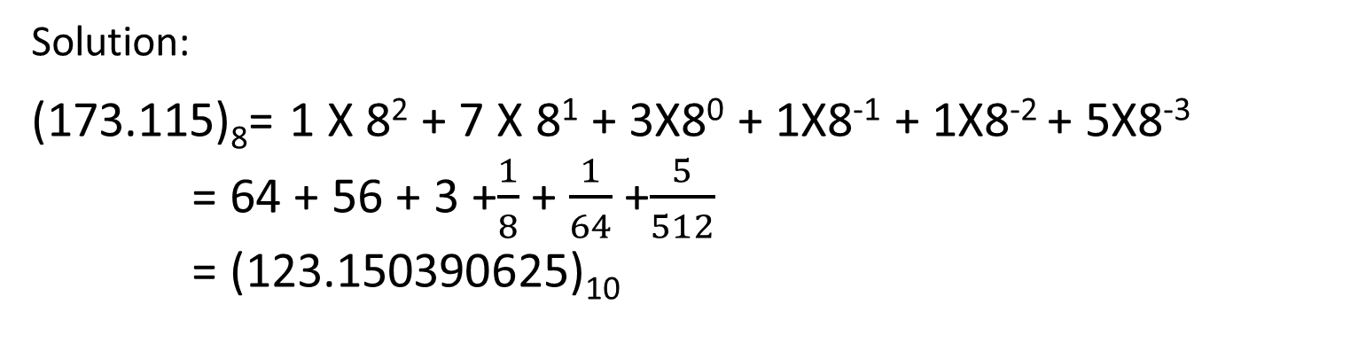
Octal → Decimal
(173.115)₈= ( )₁₀
^{Solution:}
(173.115)₈= 1 X 8² + 7 X 8¹ + 3X8⁰ + 1X8⁻¹ + 1X8⁻² + 5X8⁻³
= 64 + 56 + 3 +$\frac{1}{8}$ + $\frac{1}{64}$ +$\frac{5}{512}$
= (123.150390625)₁₀

Slide 11
Octal → Decimal
Try Solving yourself
(2331)₈
(33215.566)₈

Slide 12
Hexadecimal → Decimal
(A05.2B1)₁₆= ( )₁₀
^{Solution:}
(A05.2B1)₁₆ = A X 16² + 0 X 16¹ + 5X16⁰ + 2X16⁻¹ + BX16⁻² + 1X16⁻³
= 10 X 16² + 0 X 16¹ + 5X16⁰ + 2X16⁻¹ + 11X16⁻² + 1X16⁻³ = (2565.168212890625)₁₀

Slide 13
Hexadecimal → Decimal
Try Solving yourself
(CD421.A232)₁₆
(223B.12C)₁₆

Slide 14
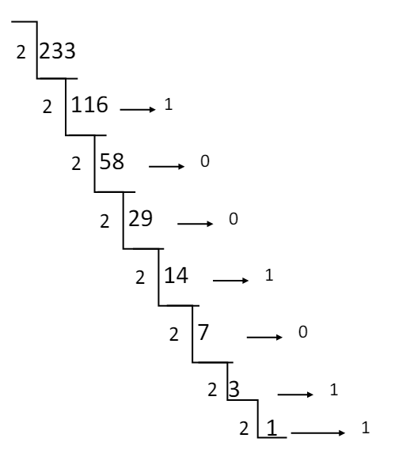
Decimal → Binary
(233.54)₁₀ =( )₂
0.54 * 2 = 1.08 → 1
0.08 * 2 = 0.16 → 0
0.16 * 2 = 0.32 → 0
0.32 * 2 = 0.64 → 0
0.64 * 2 = 1.28 → 1
0.28 * 2 = 0.56 → 0
0.56 * 2 = 1.12 → 1
0.12 * 2 = 0.24 → 0
0.24 * 2 = 0.48 → 0
0.48 * 2 = 0.96 → 0
0.96 * 2 = 1.92 → 1
0.92 * 2 = 1.84 → 1
(233)₁₀ =(11101001) ₂
(0.54)₁₀ =(.100010100011) ₂
(233.54)₁₀ =(11101001.100010100011)₂
0
1

Slide 15
Decimal → Binary using 2n Digits
(205)₁₀ =( )₂
We can write 205 in this way, how?
205 = 128 + 64+ 8+ 4 +1
Decimal | 2⁷ = 128 | 2⁶ = 64 | 2⁵ = 32 | 2⁴ = 16 | 2³ = 8 | 2² = 4 | 2¹ = 2 | 2⁰ = 1
Binary | 1 | 1 | 0 | 0 | 1 | 1 | 0 | 1
(205)₁₀ =(11001101)₂

Slide 16
Decimal → Octal
(233.54)₁₀ =( )₈
8
233
0.54 * 8 = 4.32 →4
0.32 * 8 = 2.56 →2
0.56 * 8 = 4.48 →4
0.48 * 8 = 3.84 →3
0.84 * 8 = 6.72 →6
0.72 * 8 = 5.76 →5
(233)₁₀ =(351) ₈
(0.54)₁₀ =(.424365) ₈
(233.54)₁₀ =(351. 424365)₂
8
29
1
8
3
5
0
3

Slide 17
Decimal → Hexa-Decimal
(233.54)₁₀ =( )₁₆
16
233
0.54 * 16 = 8.64 → 8
0.64 * 16 = 10.24 → 10 (A)
16
14
9
0
14
E
(233)₁₀ =(E9) ₁₆
(0.54)₁₀ =(.8A) ₁₆
(233.54)₁₀ =(E9. 8A)₁₆

Slide 18
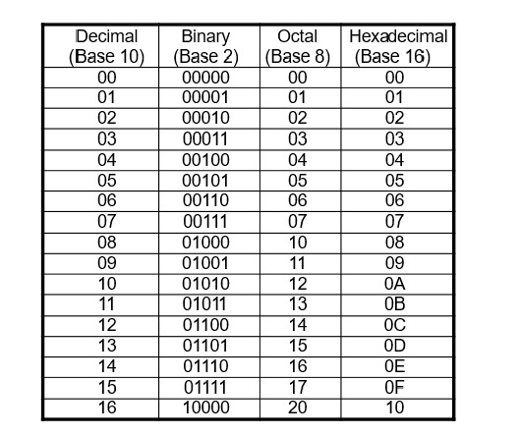
Numbers in Different Bases

Slide 19
Octal ↔ Binary
Octal → Binary
Restate the octal as three binary digits starting at the radix point and going both ways.
Binary → Octal
Group the binary digits into three-bit groups starting at the radix point and going both ways, padding with zeros as needed in the fractional part.
Convert each group of three bits to an octal digit.

Slide 20
Octal ↔ Binary
Octal to Binary:
Restate the octal as three binary digits starting at the radix point and going both ways.
(351)₈
(351)₈ =( ) ₂
011
001
101
(351)₈ =(011101001) ₂

Slide 21
Octal ↔ Binary
Octal → Binary
Restate the octal as three binary digits starting at the radix point and going both ways.
(351.721)₈ =(?) ₂
(351.721)₈
011
101
001
111
010
001
(351.721)₈ =(011101001.111010001) ₂

Slide 22
Octal ↔ Binary
Binary → Octal
(1100100.11001)₂ =(?) ₈
(1100100.11001)₈
001
100
100
110
010
Padding with 0
1
4
4
6
2
(1100100.11001)₈ =(144.62) ₂

Slide 23
Hexa-Decimal ↔ Binary
Hexadecimal → Binary
Restate the Hexadecimal as four binary digits starting at the radix point and going both ways.
Binary → Hexadecimal
Group the binary digits into four-bit groups starting at the radix point and going both ways, padding with zeros as needed in the fractional part.
Convert each group of three bits to a Hexadecimal digit.

Slide 24
Hexa-Decimal ↔ Binary
Hexadecimal → Binary
Restate the Hexadecimal as four binary digits starting at the radix point and going both ways.
(65.DC)₁₆ =( ) ₂
(65.DC)₁₆
0110
0101
1101
1100
(65.DC)₁₆ =(01100101.11011100) ₂

Slide 25
Octal ↔ Binary
Binary → Hexadecimal
(001100101.110111)₂ =(?) ₁₆
(001100101.110111)₁₆
0000
0110
0101
1101
1100
Padding with 0
0
6
5
D
C
(001100101.110111)₂ =(065.DC) ₁₆

Slide 26
Octal ↔ Hexadecimal
No Direct Approach!!!!!!
Octal
↔
Binary
↔
Hexadecimal
Convert octal number (635.177)₈ into hexadecimal number
Convert the number (19D.3F8)₁₆ into octal number.

Slide 27
Topic Binary Arithmetic

Slide 28
Binary Addition
4 Cases
0 + 0 = 0 Carry=0
0 + 1 = 1 Carry=0
1 + 0 = 1 Carry=0
1 + 1 = 0 Carry=1
Carry
1 1 0 1 1 1 0
Add the Following :
1 0 1 1 1 + 1 1 0 0 0 1 = ?
10001 + 11101 = ?
1 0 1 1 1
(+) 1 1 0 0 0 1
1 0 0 1 0 0 0

Slide 29
Binary Subtraction
4 Cases
0 - 0 = 0
0 - 1 = 1 (Borrow)
1 - 0 = 1
1 - 1 = 0
Borrow
1 1 1 0
Subtract the Following :
1110 - 111 = ?
11011 + 10110 = ?
1 1 1 0
(-) 1 1 1
1 1 1

Slide 30
Binary Subtraction (2’s Complement)
(12)₁₀ - (8)₁₀ = ( )₂
(8)₁₀ = (1000)₂
(-8)₁₀ = ?? (No representation)
Representation of a negative number:
Write the number in 8 bit, padding with 0’s the rest bit (MSB)
Toggle all the values (0→1, 1→0), which is known as 1’s complement.
Then add (+1) with 1’s complement.
The process is called 2’s complement.

Slide 31
Binary Subtraction (2’s Complement)
(12)₁₀ - (8)₁₀ = (??)₂
(12)₁₀ = (1100)₂
(-8)₁₀ = (11111000)₂
(12)₁₀ + (-8)₁₀ = (??)₂
00001100
(+)11111000
Neglect
1 00000100

Slide 32
Binary Multiplication
4 Cases
0 X 0 = 0
0 X 1 = 0
1 X 0 = 0
1 X 1 = 1
1010
(x) 1011
1010
1010X
11110
0000XX
Multiply the Following
1010 X 1011 = ?
011110
1010XXX
1101110

Slide 33
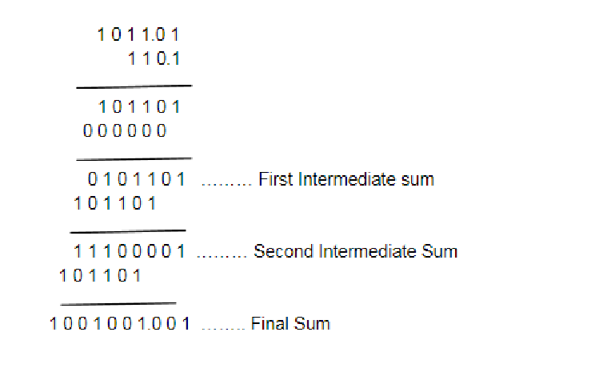
Binary Multiplication
4 Cases
0 X 0 = 0
0 X 1 = 0
1 X 0 = 0
1 X 1 = 1

Slide 34
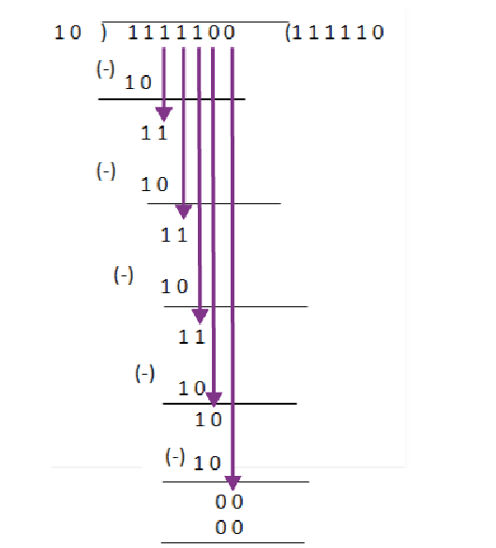
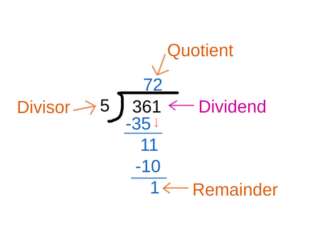
Binary Division
Divide 1111100 by 10
Divide 128 by 2

Slide 35
Binary Division
• Let us divide 128 by 8
• Let us divide 101010 by 110
• Now divide 26 by 5
• Do the same , but in binary : 11010 divided by 101

Slide 36
Topic Binary Codes

Slide 37
Binary Numbers and Binary Coding
Flexibility of Representation
• Within constraints below, can assign any binary combination (called a code word) to any data as long as data is uniquely encoded.
Information Types
• Non-numeric
• Greater flexibility since arithmetic operations not applied.
• Not tied to binary numbers
• Numeric
Must represent range of data needed
Very desirable to represent data such that simple, straightforward computation for common arithmetic operations permitted
Tight relation to binary numbers

Slide 38
Binary Coding ( Non-Numeric)
Given n binary digits (called bits), a binary code is a mapping from a set of represented elements to a subset of the 2^{n} binary numbers.
Example: A binary code for the seven colors of the rainbow
Color | Binary Number
Red | 000
Green | 001
Orange | 010
Yellow | 011
Blue | 101
Indigo | 110
Violate | 111

Slide 39
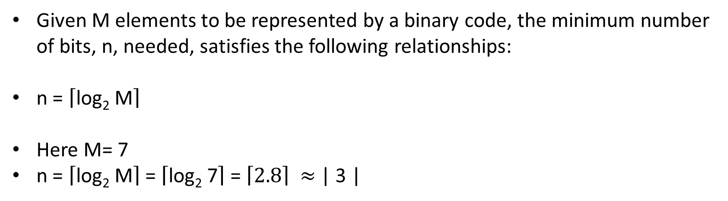
Binary Coding ( Non-Numeric)
Given M elements to be represented by a binary code, the minimum number of bits, n, needed, satisfies the following relationships:
n = $\left\lceil \text{log}\text{2} \text{M}\right\rceil$
Here M= 7
n = $\left\lceil \text{log}\text{2} \text{M}\right\rceil$= $\left\lceil \text{log}\text{2}\text{ 7}\right\rceil$= $\left\lceil \text{2.8}\right\rceil ≈$ | 3 |
Color | Binary Number
Red | 000
Green | 001
Orange | 010
Yellow | 011
Blue | 101
Indigo | 110
Violate | 111

Slide 40
Binary Coding ( Non-Numeric)
Suppose you are using n number of digits, in radix r, there are maximum of r^{n} distinct elements that can be represented.
Examples :
You can represent 4 elements in radix r = 2 with n = 2 digits: (00, 01, 10, 11).
You can also represent 4 elements in radix r = 2 with n = 4 digits: (0001, 0010,0100, 1000).

Slide 41
Binary Coding (Numeric)
There are over 8,000 ways that you can chose 10 elements from the 16 binary numbers of 4 bits. A few are useful:
Decimal | 8,4,2,1 | Excess 3 | 8,4,-2,-1 | Gray
0 | 0000 | 0011 | 0000 | 0000
1 | 0001 | 0100 | 0111 | 0001
2 | 0010 | 0101 | 0110 | 0011
3 | 0011 | 0110 | 0101 | 0010
4 | 0100 | 0111 | 0100 | 0110
5 | 0101 | 1000 | 1011 | 0111
6 | 0110 | 1001 | 1010 | 0101
7 | 0111 | 1010 | 1001 | 0100
8 | 1000 | 1011 | 1000 | 1100
9 | 1001 | 1100 | 1111 | 1101

Slide 42
Binary Coded Decimal
Each decimal digit is represented by a 4 bit binary number.
10 base system or radix 10 system
It has binary representations for 10 different digits 0 to 9
Weighted code with positional weights 8 4 2 1

Slide 43
Binary Coded Decimal
Warning: Conversion or Coding?
Do NOT mix up conversion of a decimal number to a binary number with coding a decimal number with a BINARY CODE.
13₁₀ = 1101₂ (This is conversion)
13 ⇔ 0001|0011 (This is coding)

Slide 44
Binary Coded Decimal
Decimal | 8,4,2,1
0 | 0000
1 | 0001
2 | 0010
3 | 0011
4 | 0100
5 | 0101
6 | 0110
7 | 0111
8 | 1000
9 | 1001
Decimal | 8,4,2,1
10 | 1010
11 | 1011
12 | 1100
13 | 1101
14 | 1110
15 | 1111
Valid
Invalid

Slide 45
Binary Coded Decimal
Representation of a decimal number with Binary Coded Decimals
13 ⇔ 0001|0011
12 ⇔ 0001|0010
156 ⇔ 0001|0101|0110

Slide 46
Binary Coded Decimal
BCD number to decimal number
10100 ⇔ 1 4
1001001 ⇔4 9

Slide 47
Binary Coded Decimal
Tradeoffs between binary number and packed BCD (BCD coded number)
BCD takes more storage
Addition takes additional steps
Decimal to BCD does not take much time

Slide 48
Binary Coded Decimal
Tradeoffs between binary number and packed BCD (BCD coded number)
BCD takes more storage
Addition takes additional steps
Decimal to BCD does not take much time

Slide 49
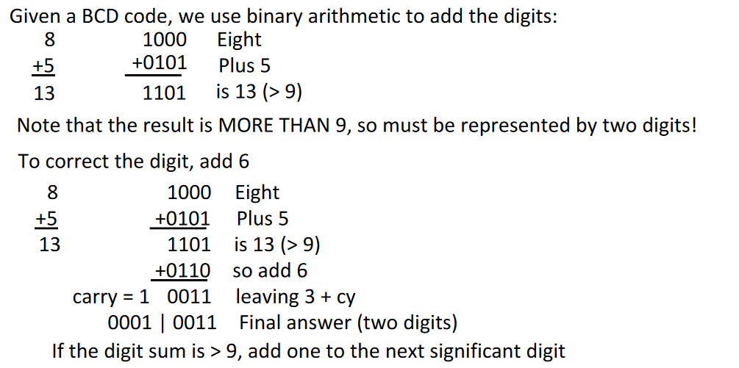
BCD Arithmetic

Slide 50
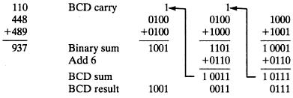
BCD Arithmetic
448 + 489 = ( )_{BCD}

Slide 51
BCD Arithmetic
Add 2905_{BCD} to 1897_{BCD} showing carries and digit corrections.
0001 1000 1001 0111
+ 0010 1001 0000 0101

Slide 52
BCD (Excess 3)
You know how to convert to binary
You know how to add
So, convert to binary and just add 0011 (3)
Decimal | 8,4,2,1 | Excess 3
0 | 0000 | 0011
1 | 0001 | 0100
2 | 0010 | 0101
3 | 0011 | 0110
4 | 0100 | 0111
5 | 0101 | 1000
6 | 0110 | 1001
7 | 0111 | 1010
8 | 1000 | 1011
9 | 1001 | 1100

Slide 53
BCD Arithmetic (Gray Code)
Discovered by Frank Gray
Unweighted code
Two successive values differ in only 1 bit
Binary numbers are converted to gray code, to reduce switching operations
Also known as Unit distance code

Slide 54
BCD (Gray Code)
Decimal | Binary | Gray
0 | 0000 | 0000
1 | 0001 | 0001
2 | 0010 | 0011
3 | 0011 | 0010
4 | 0100 | 0110
5 | 0101 | 0111
6 | 0110 | 0101
7 | 0111 | 0100
8 | 1000 | 1100
9 | 1001 | 1101
10 | 1010 | 1111

Slide 55
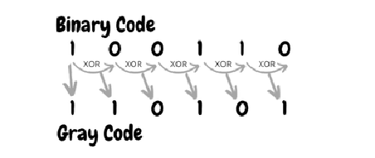
Binary to Gray Code
Step1 : Record the MSB as it is
Step 2 : Add the MSB to the next bit, record the sum and neglect the carry
Step 3 : Repeat the process

Slide 56
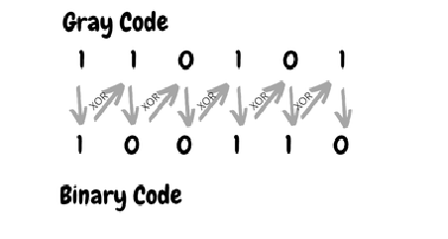
Gray Code to Binary
Step1 : Record the MSB as it is
Step 2 : Add MSB to the next bit of Gray code, record the sum and neglect the carry
Step 3 : Repeat the process

Slide 57
Representation using binary numbers
Try yourself
You want to represent all the countries in the world, using binary numbers. How many bits are required to do so?

Slide 58
Representation using binary numbers
Try yourself
You want to represent all the countries in the world, using binary numbers. How many bits are required to do so?
Total number of countries = 195
Ans: 8 bits

Slide 59
Representation using binary numbers
Suppose you have a register that can contain 4 bits, how many elements/ pieces of information can you represent?

Slide 60
Representation using binary numbers
Suppose you have a register that can contain 4 bits, how many elements/ pieces of information can you represent?
Ans: 2^{n} = 2⁴= 16

